Slide 1
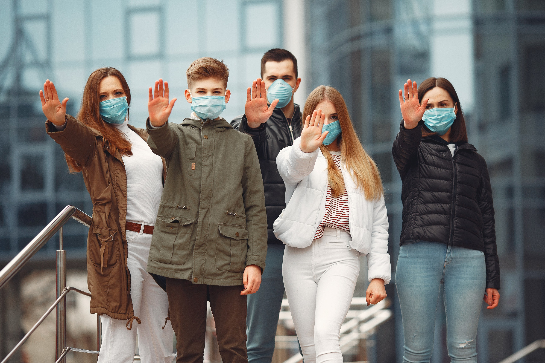
CoviChat
CODE INNOVATION SERIES - MAHARAJA AGRASEN INSTITUTE OF TECHNOLOGY
You Use the app, We Do the Rest.
01
Presented By - Team Kgtechies

Slide 2



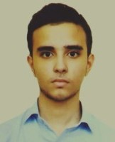
Core Team
Arihant Jain
Anuj Dhingra
Shivam Singh
Trijal Bhardwaj
03

Slide 3

What We Do
The rationale behind this app is to connect the dire needs of the people in this pandemic situation with Verified Leads, Doctors and Resources.
This App aims to improve and solve the current situation in the following ways :
Enables a Patient-Centered Information Exchange System.
Personal Medical-Assistant within the App.
05

Slide 4
Tech Stacks, Technologies and Frameworks Used
07

Slide 5

ABSTRACT
The present pandemic situation in India is very alarming and critical. In fact, the people in dire need of healthcare support are not even getting life-saving medicines.
This project is all about improving this situation . Thus, we are creating a patient-centred information exchange system, in which the people who have fully recovered from the disease and want to donate and help the rest of the people who are in need of medical and healthcare support, can now directly communicate with and help each other through this chatting application.
The purpose of this is the same way a doctor can utilize his/her time and resources to help critical patients with personal assistance.

Slide 6
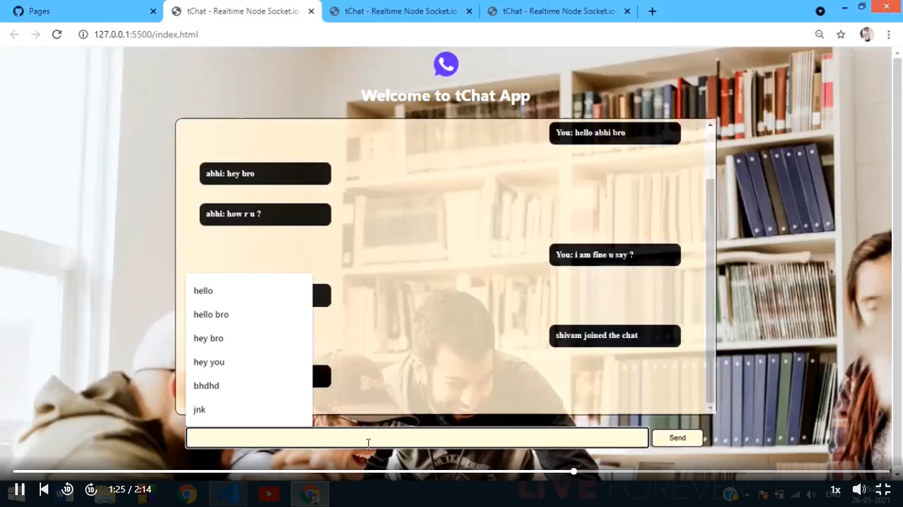
UI DESIGN (CLONE)

Slide 7
ADVANTAGES
THERE WILL BE NO NEED TO STEP OUT FROM YOUR HOME TO FIND AND SEARCH FOR MEDICAL SUPPORT. GET DOCTOR’S ASSISTANCE AT YOUR PLACE ONLY.
THE NEEDY ONES CAN GET LIFE SAVING MEDICINES.
THEY CAN ALSO GET EQUIPMENTS AND BLOOD,PLASMA,ETC FROM FULLY RECOVERED PEOPLE WILLING TO DONATE.

Slide 8
References & Resources
https://www.incubateind.com/hack/mait/
https://www.youtube.com/watch?v=3QNBVG2yqKA
https://javascript.info
https://pptr.dev/

